Slide 1



TEAM 59
CODE FOR GOOD ‘24
SOLUTIONS TO PROBLEMS FACED BY
Vowels of The People Association

Slide 2
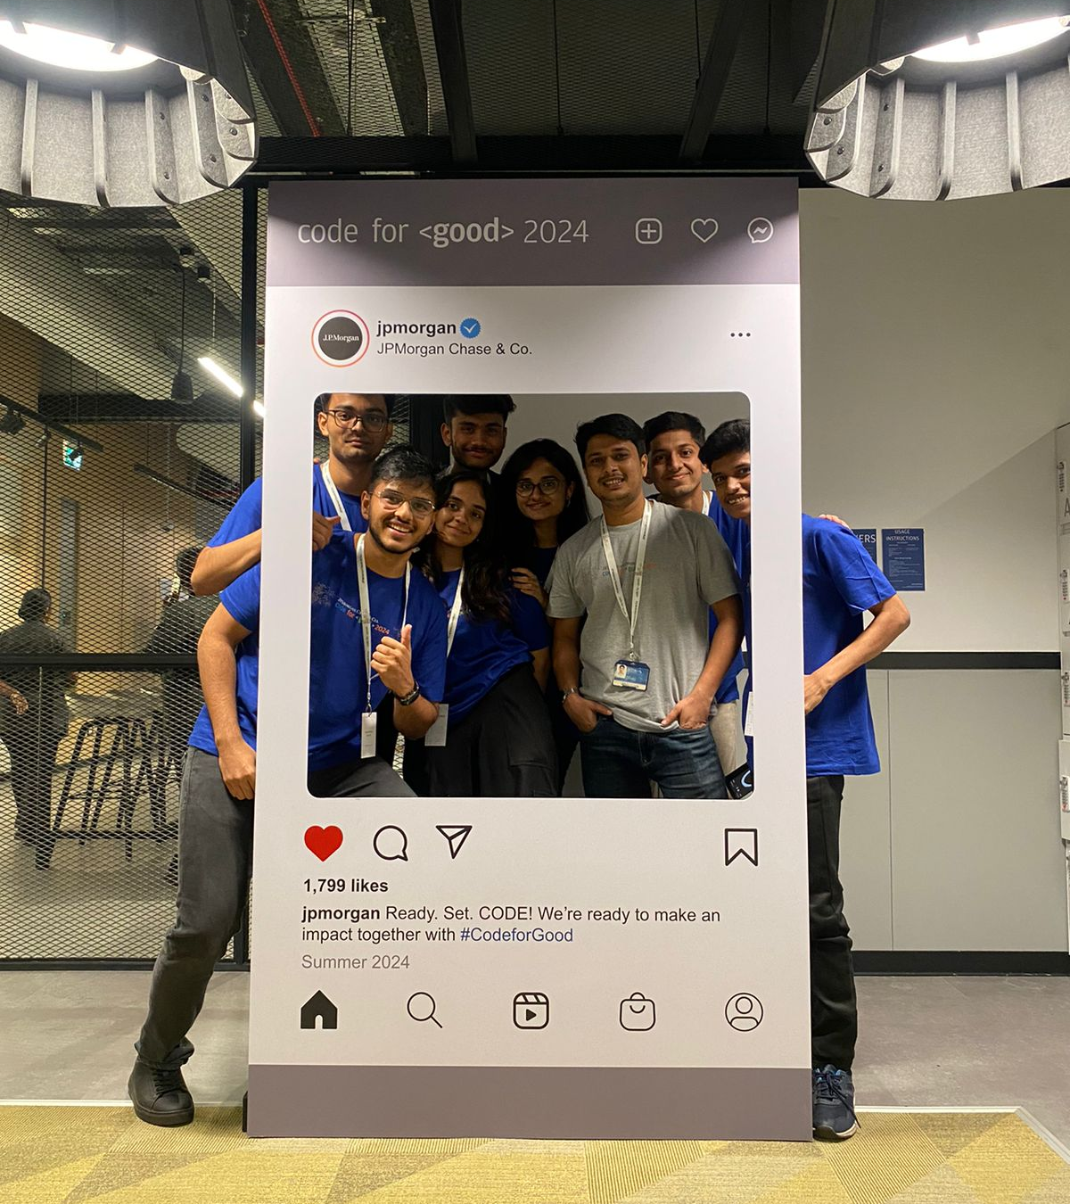
MEET THE TEAM

Slide 3



OUR MISSION
Aligning with the heart touching mission of the Voice of the People Foundation , We with our effort aim to make education easily accessible , free of all biases and a fun process by providing services to the NGO , understanding their problem and providing sustainable solutions by meeting their requirements

Slide 4
OUR VISION
To provide a technical solution that automates the testing process , thus making education easily accessible , free of biases and equitable by automating the testing process and making learning fun

Slide 5
CHALLENGES FACED:
Challenge | Objective
Current State: The assessments or tests are currently done manually and offline. | Objective: VoPA Foundation aims to automate and standardize the assessment system using their mobile application.
Challenge: This manual process is time-consuming and prone to inconsistencies, making it difficult to standardize and automate the assessment process. | Challenge: Developing a module that can be used by teachers to assess students on literacy and numeracy in a consistent and automated manner.

Slide 6
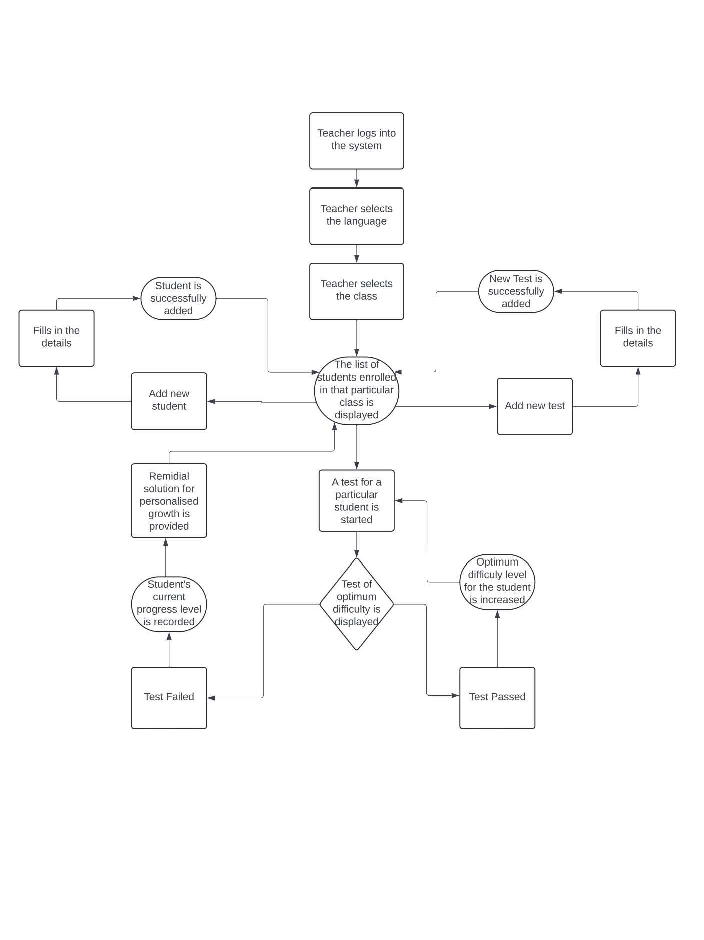
WORK FLOW
Processes
Login Page: Existing users can log in.
Sign Up Page: New users can sign up and be added to the database.
Language Selection Page: Users select a language.
Class Selection Page: Users choose a class.
Class Details Page: Displays all students in the selected class and allows adding new students.
Student Testing Page: Users can test a student.

Slide 7
WORK FLOW
Process Flow
Login Process:
Input: User credentials.
Output: Access to the system if credentials are valid.
Sign Up Process:
Input: New user details.
Output: New user added to the database.
Language Selection Process:
Input: User's language choice.
Output: Language preference set.
Class Selection Process:
Input: User's class choice.
Output: Class details displayed.
5. Class Details Process:
Input: User's request to view or add students.
Output: List of students displayed or new students added to the database.
6. Student Testing Process:
Input: User's request to test a student.
Output: Student testing interface displayed.
7. ML-Based Testing System:
Input: Student's spoken response.
Output:
a)If correct: Move to the next level.
b)If wrong: Allow retry.
c)If wrong again: Suggest ways to improve.

Slide 8
OUR ATTEMPT AT A SOLUTION
Creating a standardized examining pattern that takes in multiple aspects of speech being-
TEXTUAL ANALYSIS
Contextual meaning leveraging NLP
Accuracy of words leveraging TF-IDF
Relative ordering of words leveraging dynamic programming
SPEECH ANALYSIS
Correct Pronunciation using Google translate keeping in mind the Indian dialect
Real Time Audio
Checks Audio Similarity

Slide 9
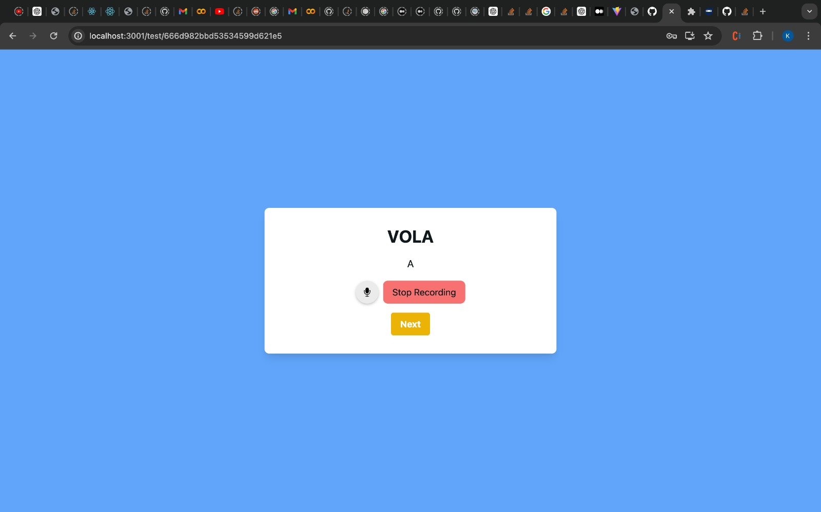
KEY FEATURES
Feature One:

Slide 10
KEY FEATURES
WHAT IT SOLVES:
Automates the evaluation process through Phonetic analysis and Audio-to-text based assessment. Makes the whole learning process unbiased and less laborious for the teacher.

Slide 11
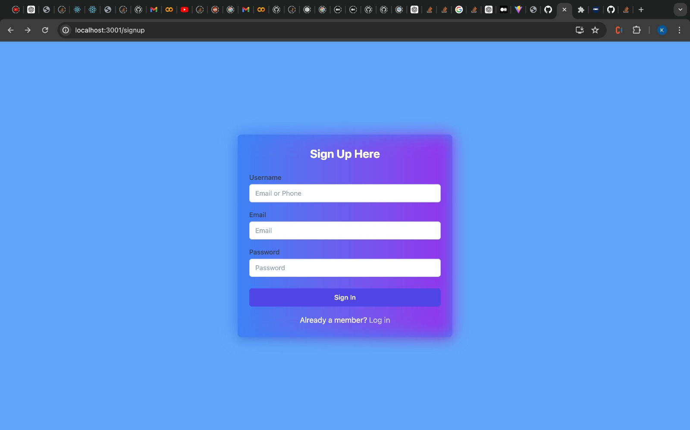
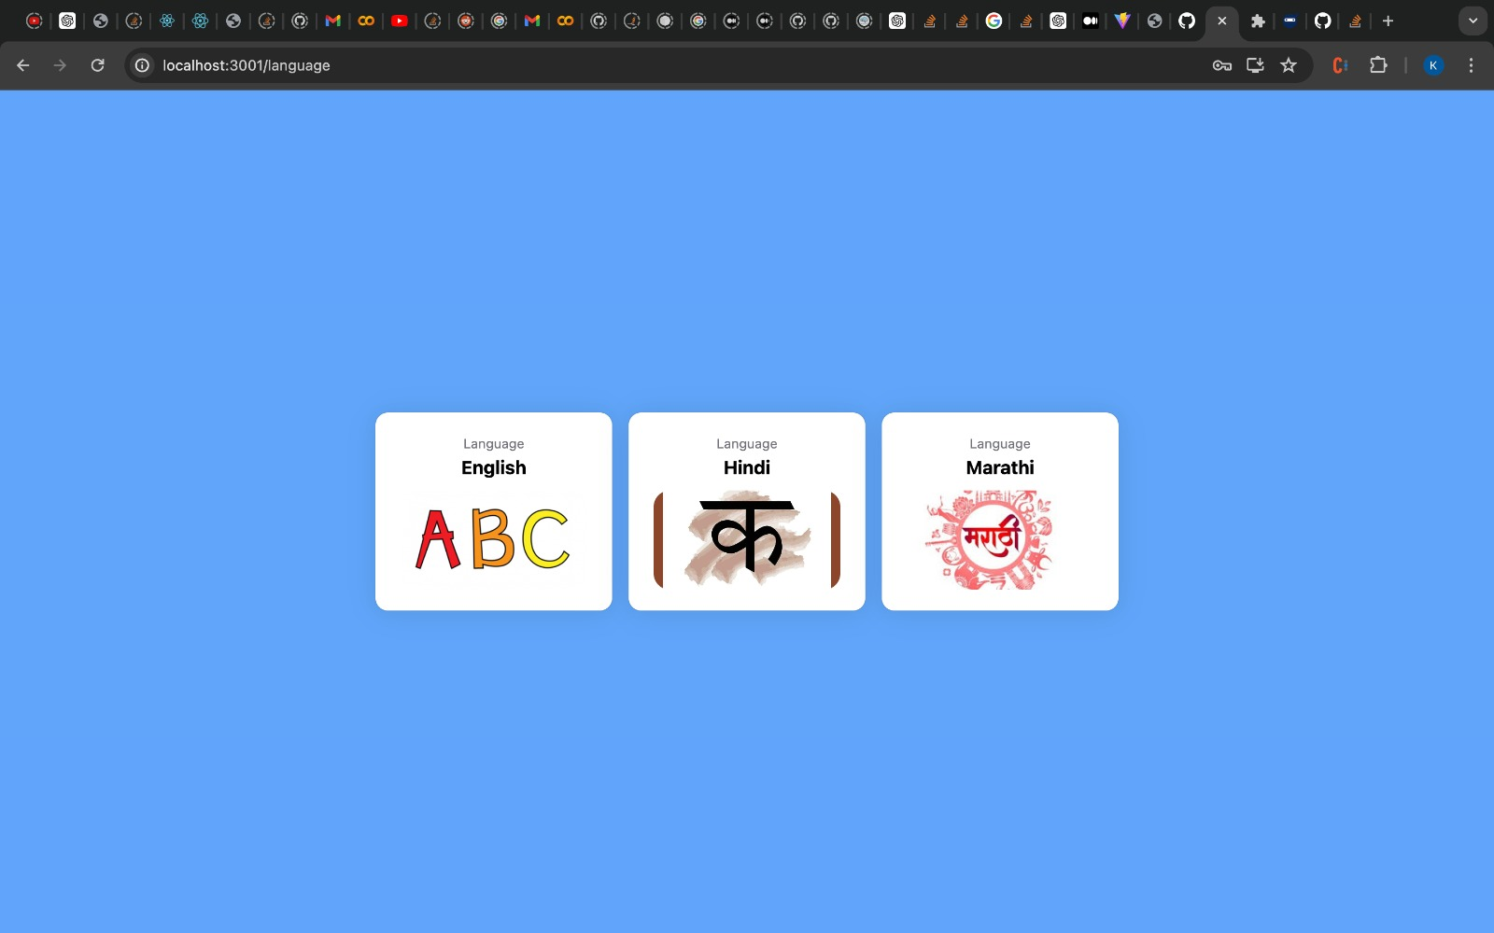
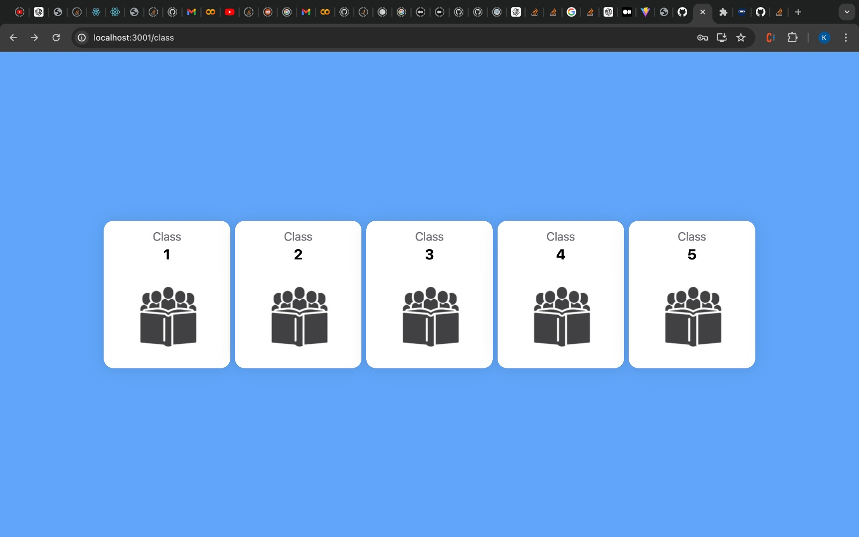
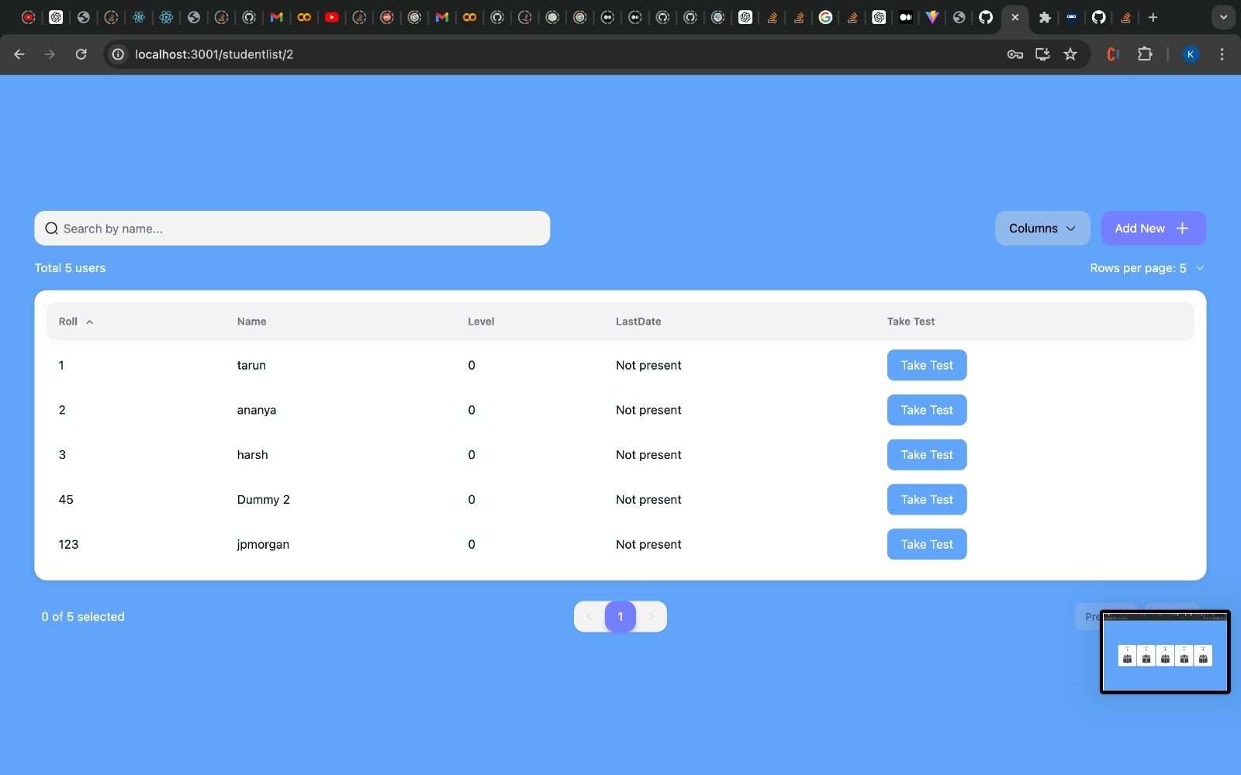

Slide 12
ADDITIONAL FEATURES
A positive learning environment is essential for effective education. To support students who experience difficulties, we provide modules incorporating both audio and visual elements, making learning enjoyable and improving information retention. These remedial solutions are designed to enhance the overall learning experience, ensuring that students not only understand the material but also retain it longer. By integrating these engaging tools, we aim to make learning both effective and fun.

Slide 13
ADDITIONAL FEATURES
REMEDIAL SOLUTIONS
l
LE
LEVEL
ONE
LEVEL
TWO
LEVEL THREE

Slide 14
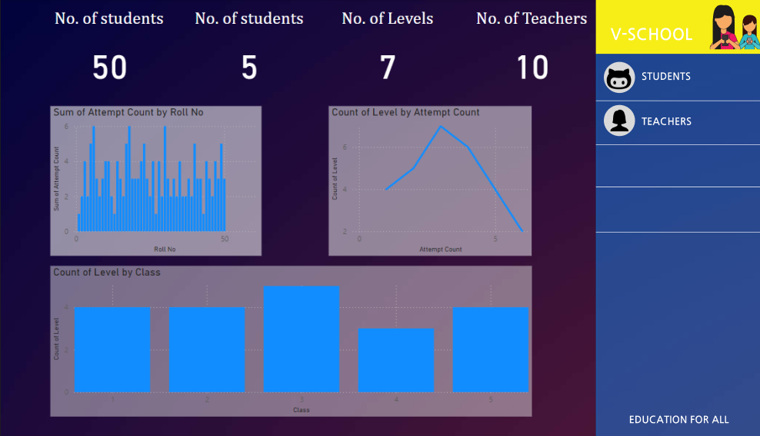
ADDITIONAL
FEATURES
Dashboard analysing a mock data of what levels students have issues with and how many attempts they require , thus providing feedback on the teaching methods

Slide 15



Division of the Learning Process
FUTURE ENHANCEMENTS
By adding an (Easy , Medium , Hard) into the system , we can ensure the learning process is more linear
Implementation of Practice Tests
Practice tests before the actual tests would give the students an idea on how to perform better
Adding Lip Reading
Keeping in mind the dialects used throughout the country, lip reading would be an equitable way of judging the students

Slide 16






System Architecture
TECH STACK
MACHINE LEARNING
DESIGN
DASHBOARD

Slide 17
Thank you for giving us a chance to help contribute to the betterment , we hope our effort can help provide a framework for a future solution
TEAM 59

